Slide 1


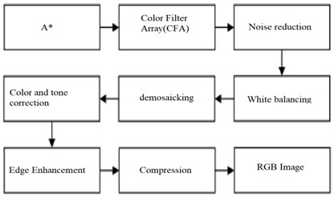
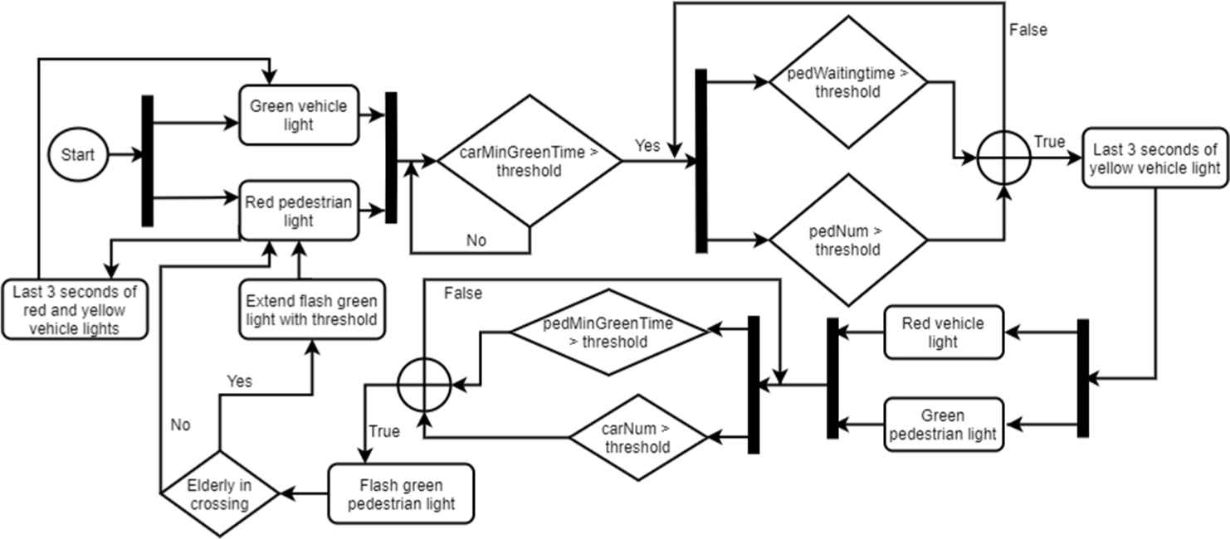

PracticeSmith
Notes:
Want to bring your practices to the 21st century? Today we live in a world where software is a part of our daily lives. These essential apps range from small to drastic improvements in the quality of life for their users. There is software that exists in a lot of the small things around us that people wouldn’t usually give a second thought to: [Click transition] such as traffic light algorithms to keep traffic at a minimum, or bits of logic in a camera for auto-exposure, color correction, and compression. [Click transition]

Slide 2
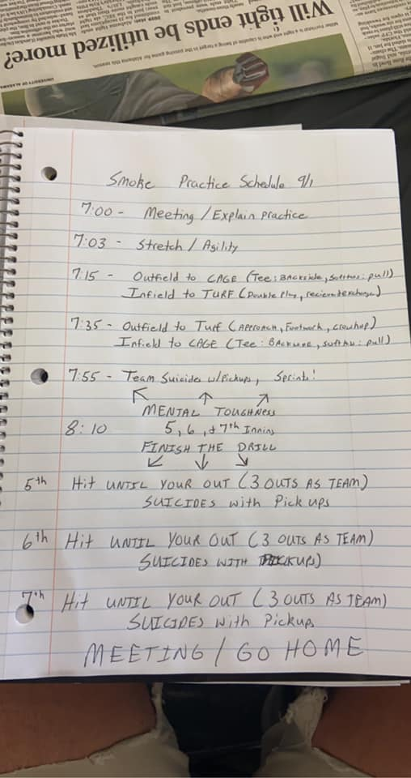
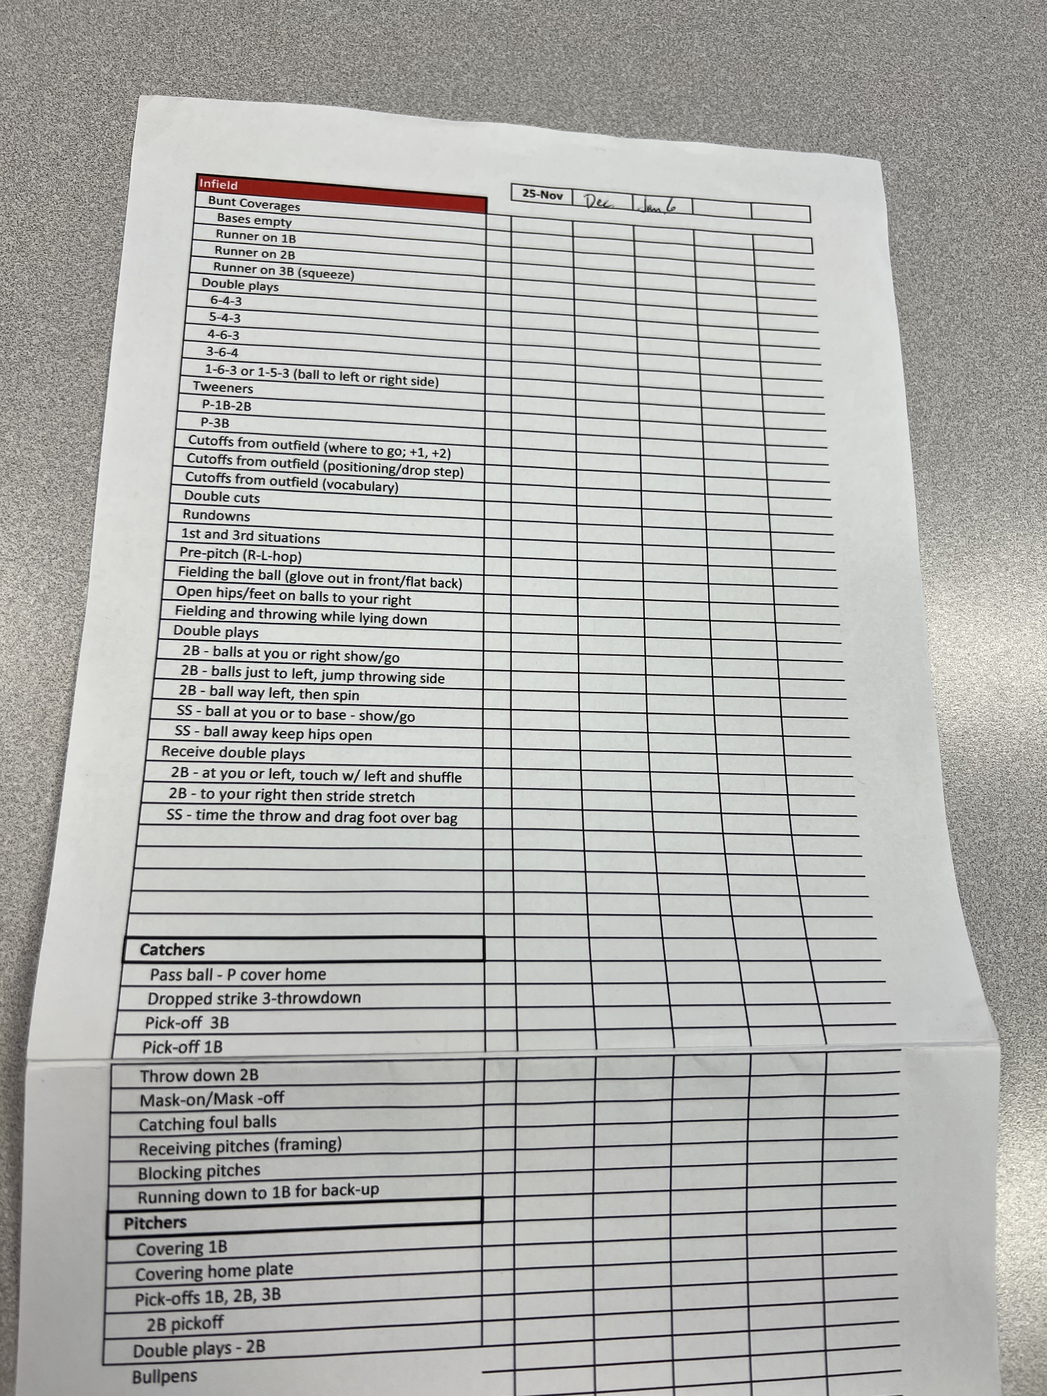
Notes:
Yet, coaches around the world are still resorting to paper and pencil and spreadsheets to produce practice plans today. We here at CU Denver are the Senior Design Team with the answer to these medieval techniques. We present to you a modernized alternative to the outdated methods that are still being used. As shown above, we have two different pictures given by our client showing one a practice plan written by hand and second a spreadsheet of the entire drill list with the drill type and the specific category. The boxes next to the drill list is to check off when the practice was used and then building a coherent plan off of what still needs to be practiced/and or trained. As you can see, this process is very time consuming, generally taking our client in total 45 minutes to create an entire practice plan. Thus, we are offering a solution to reduce the time efficiency and improving quality of making practice plan.

Slide 3
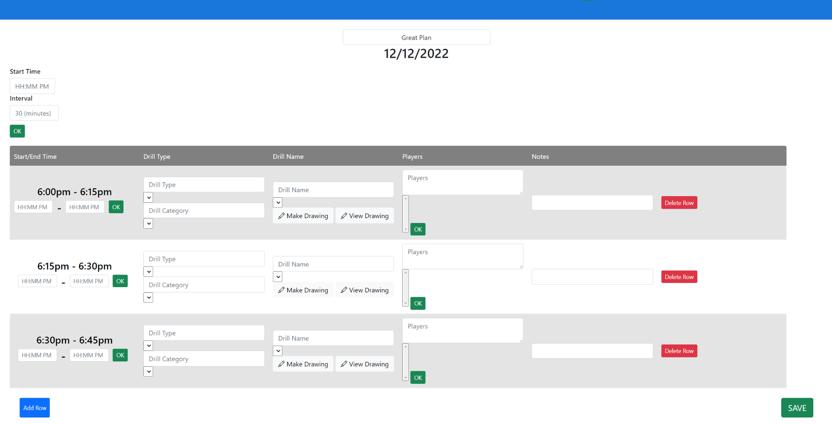
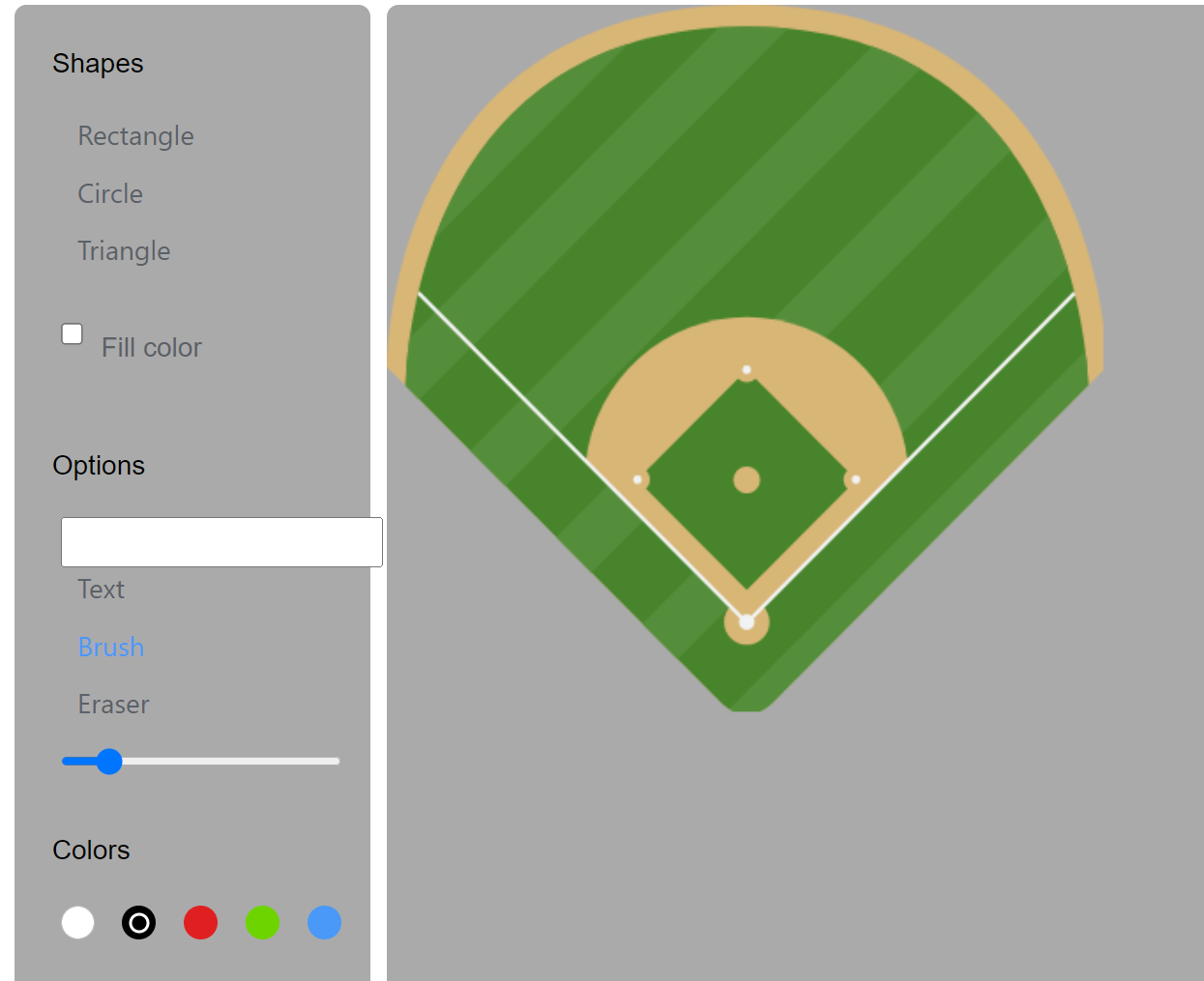
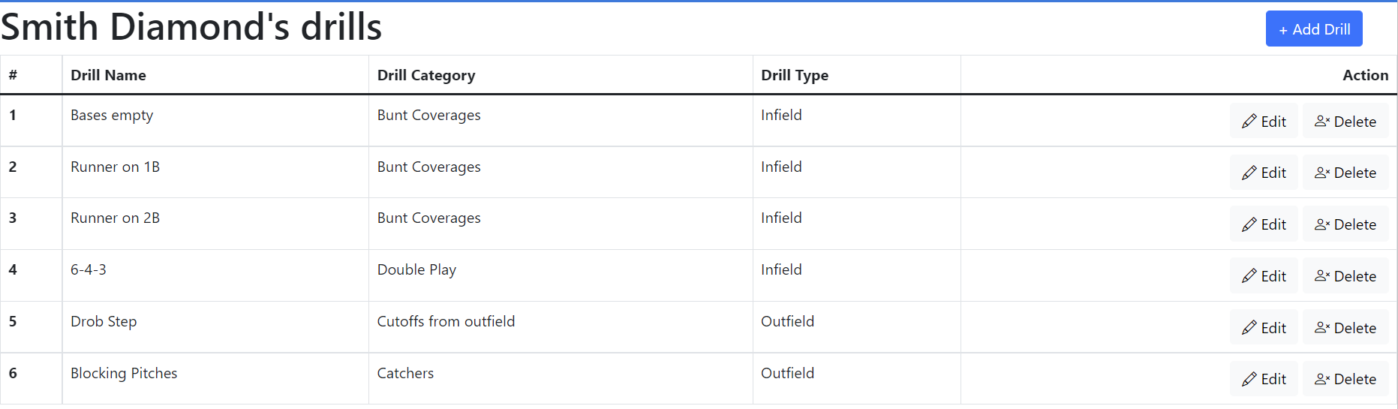
Notes:
This is PracticeSmith: The place for baseball coaches to create and manage all of their teams, players, and plans’ needs. Never again will you be going through excel spreadsheets or picking up a pencil and paper to hand draw your drills.
[Transition] With PracticeSmith, we give you all the tools necessary to plan your baseball team and practices with an organized, intuitive, and simple layout all at the convenience of your personal computer. Instead of manually checking off a list of when you did what drill, PracticeSmith infers this information from your plans and stores it, without you ever having to remember or touch anything.
[Transition] The time for pencil and paper drills is coming to an end, the future of all drill creation is here with shape, color, brush, and text tools at your disposal. It even comes with a pre-drawn empty baseball diamond as a template to save time on drawing the field with every drill. All that time spent organizing spreadsheets and filling out empty cells is also coming to an end. With PracticeSmith we save all your teams, players, and plans so that you never need to worry about stacks of paper again.

Slide 4
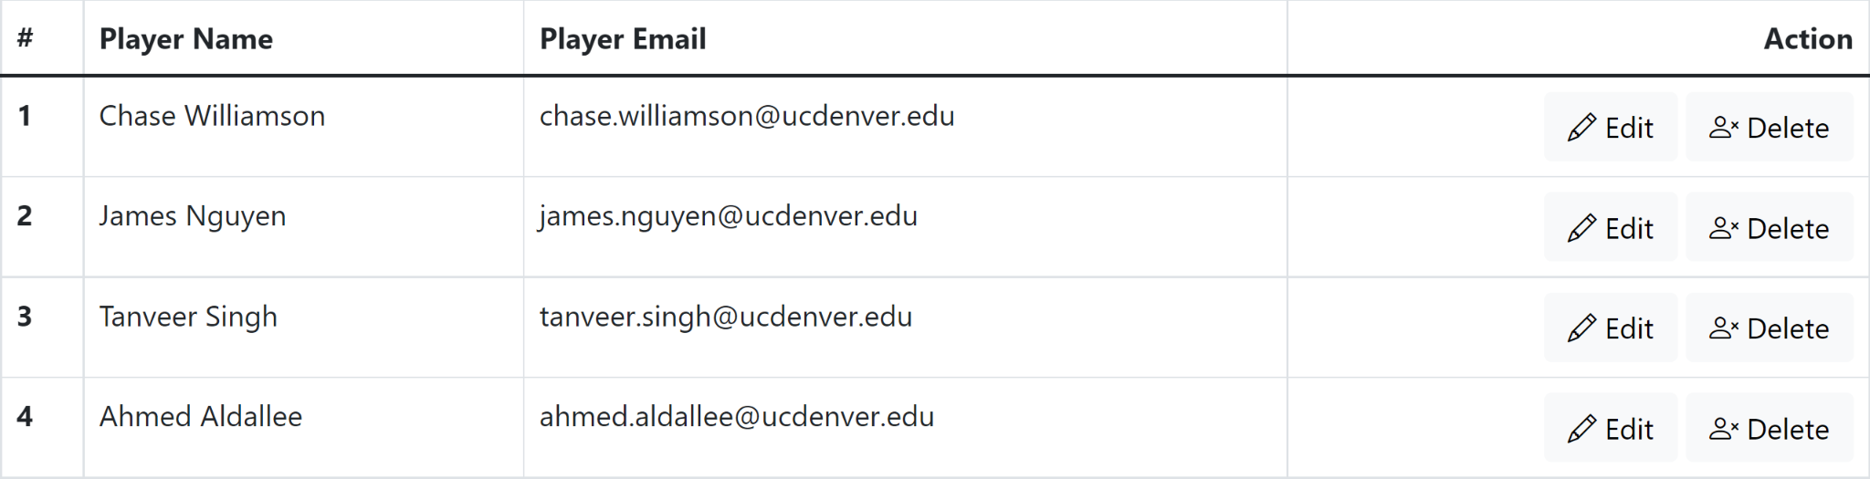
Notes:
How much time have you wasted trying to explain and re-explain how certain drills will work to your players at practice? With PracticeSmith you can cut down this wasted time and get straight to hitting balls. Send emails to parents or players containing the practice plan hours, days, or weeks in advance so when your players get to practice they already know what to do.

Slide 5
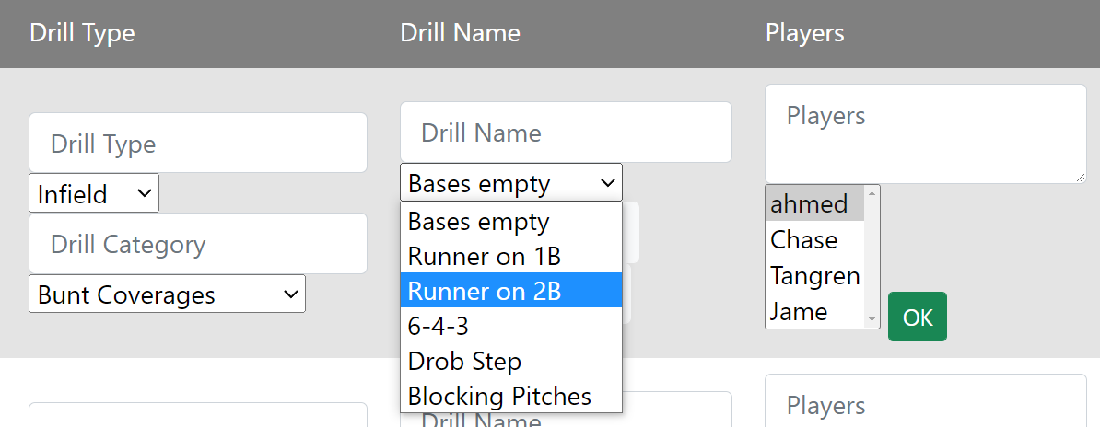
Notes:
How much time do you waste trying to remember what drills and players you have on your team? With just a single import of your data, your drills and players live in PracticeSmith and can be referenced at any time for viewing or using inside a plan. Your data is stored alongside your team, so you can differentiate between drills and players when you have multiple teams.

Slide 6




Challenges
Notes:
During the development of PracticeSmith, there were a multitude of challenges that we faced. For one, we all had very limited web development experience. For all of the technologies that we used, we had to learn most of them with zero experience. We began the development of the website with certain technologies but ended up changing some of them after learning that they made our lives easier. We also struggled with integration between various parts of the website, including integrating the graphical parts with the main practice plan page. Another issue we faced was the relationship between the players, teams, drills, and plans. We had to refactor our database schemas and relationships multiple times. We are still working on improving the flow of the website as well as making the user interface more intuitive.

Slide 7
Practice Smith
Chase WIlliamson Ahmed Aldallee Tanveer Singh
James Nguyen
Notes:
Thank you for your time. We are Team 6 aka “Practice Smith” group and THANK YOU FOR LISTENING TO OUR PRESENTATION.

